Slide 1

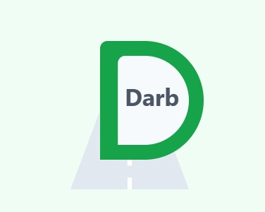
DARB
Smart mobility starts here
Team Leader - Mahmoud
Member - Hamza
Member - Ayham

Slide 2

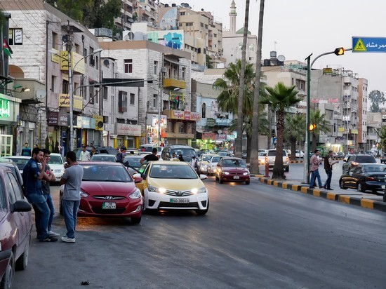
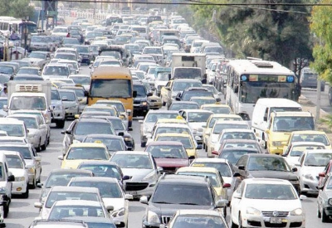
DARB IN
SIMPLE WORDS
DARB is a smart toll and monitoring system that reduces traffic, tracks vehicles, and enables fast, secure payments

Slide 3



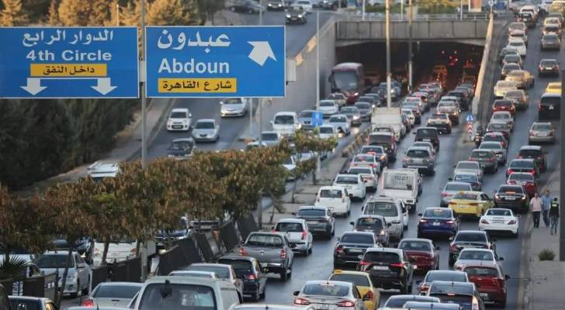
THE PROBLEM
Unlicensed or violating cars
Amman faces heavy congestion at city entrances, causing delays and frustration.
Unlicensed and wanted vehicles often bypass monitoring, creating security and revenue gaps.
Current systems are outdated — needing a smarter, faster, and more reliable solution
Road crisis

Slide 4

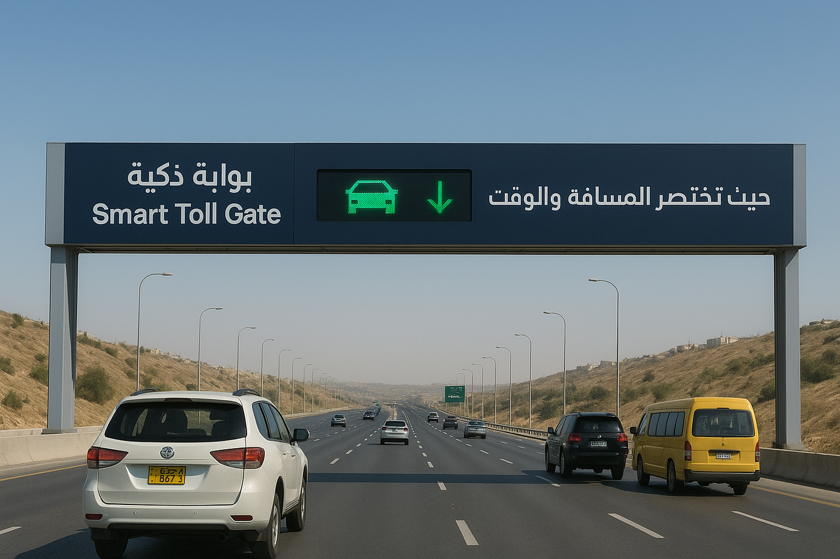
WHAT IS
DARB ?
DARB is a smart toll gate system powered by RFID and ANPR, enabling vehicles to pass seamlessly without stopping.
It provides automatic fee collection, accurate vehicle tracking, and real-time alerts for unlicensed or wanted cars.
The DARB app connects citizens directly to the system, allowing easy balance recharge, tracking usage, and managing accounts.

Slide 5
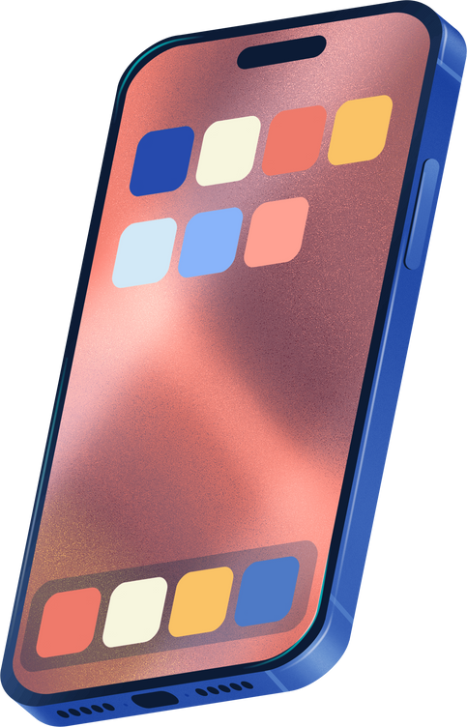




THE AI IN
DARB
Frontend: Flutter (cross-platform mobile app).
AI: GOOGLE VISION API (LICENSE PLATE RECOGNITION)
BACKEND: FIREBASE (SECURE DATA & AUTHENTICATION).
IoT: Sensors & smart cameras at gates.
UI/UX: MINIMAL, INTUITIVE, DRIVER-FRIENDLY DESIGN
Unique Edge: No stopping required + real-time data sharing with authorities

Slide 6
Serves 20,000–50,000 vehICLES DAILY WITH UP TO 4.5 MILLION JOD ANNUAL REVENUE PER GATE
1
WHY IT’S VALUABLE AND HOW iT CAN GROW
2
WHY IT’S VALUABLE AND HOW iT CAN GROW ?
FINANCIALLY SUSTAINABLE WITH FAST COST RECOVERY
3
REDUCES TRAFFIC CONGESTION AND VIOLATIONS
4
FUTURE GROWTH: NATIONWIDE EXPANSION, AI TRAFFIC MANAGEMENT, AND FULL SMART MOBILITY INTEGRATION

Slide 7
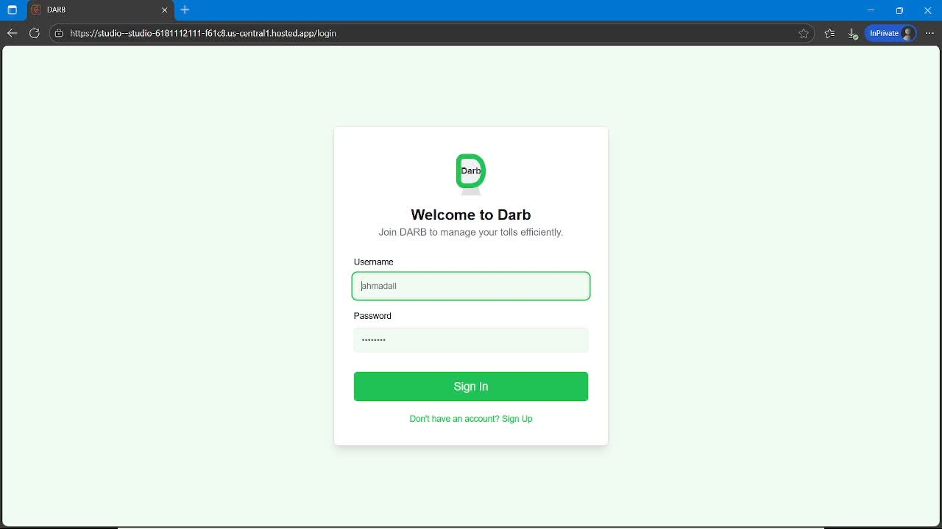
DARB
MOBILE APPLICATION
Citizens can top up balance, pay fees automatically, track violations, and receive instant notifications. Direct interaction with the system

Slide 8
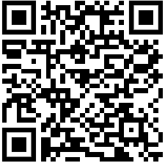
DARB
Smart mobility starts here

